Slide 1
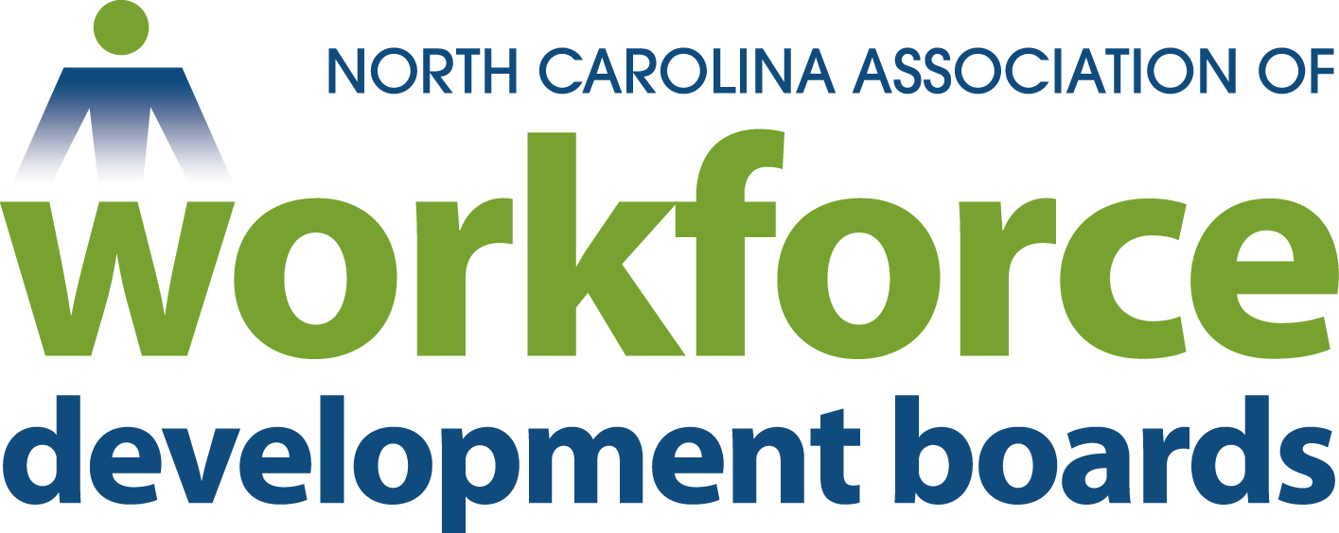
Presentation to
Joint NCWorks Commission and NCAWDB
August 9, 2016

Slide 2
Local Workforce Development Boards
A Convener - Bring together business, labor, education, and economic development, and other community groups
Inform of changing industry needs
Drive efforts to make system more effective
A catalyst for innovation

Slide 3
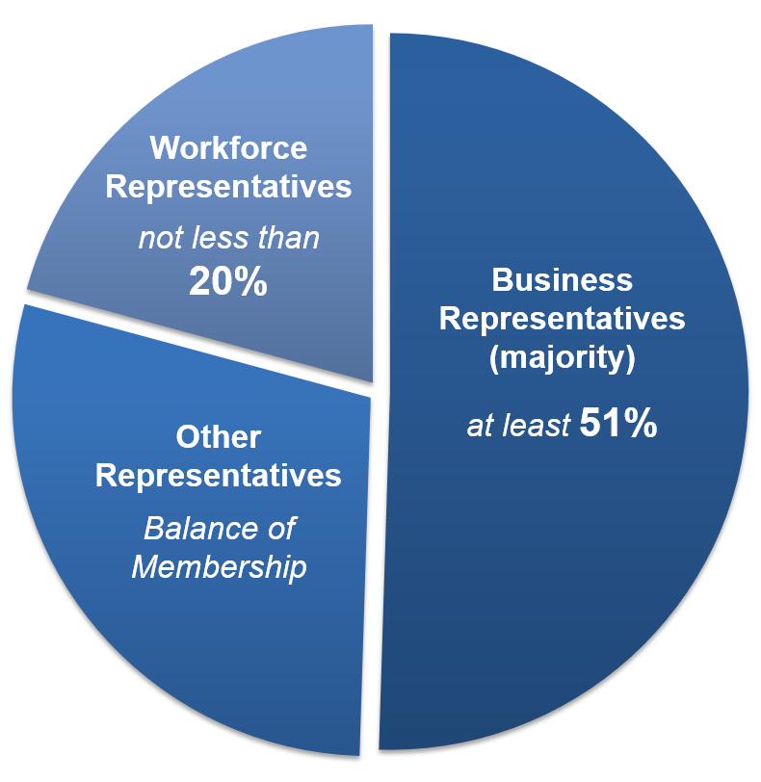
Minimum Membership
Local Workforce Board Membership
Business Representatives
Workforce Representatives
Other Representatives to include:
Adult Education/Literacy Providers
Higher Education (including community colleges)
Economic and Community Development
Wagner-Peyser Employment Services
Vocational Rehabilitation
May include others determined appropriate by chief elected officials

Slide 4
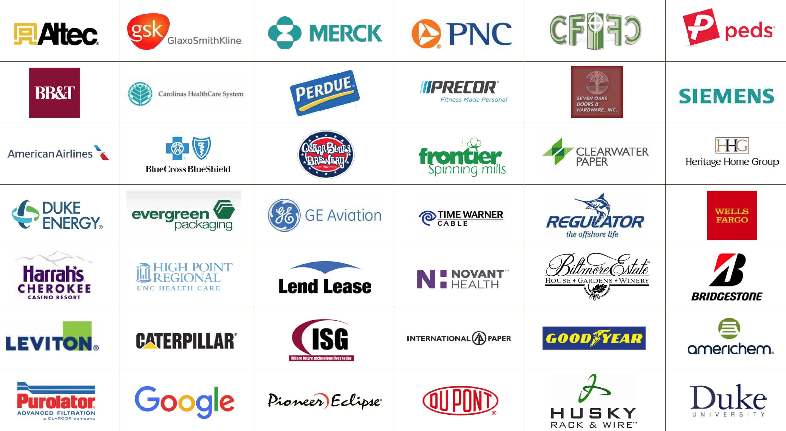

Slide 5
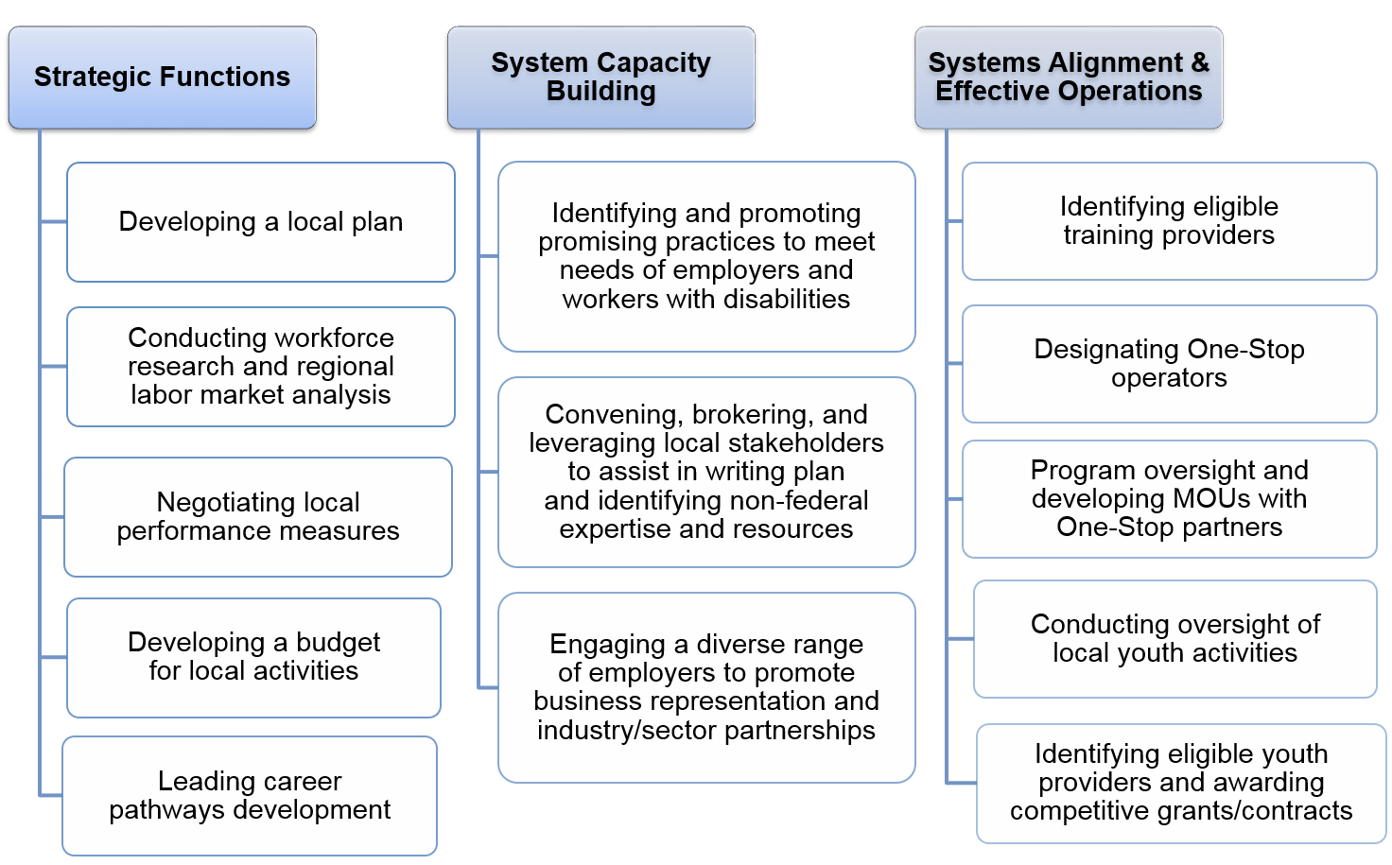
Role of Local Workforce Development Boards

Slide 6
Example_Strategic Function
Workforce research and regional labor market analysis
Workforce Boards across NC:
provide economic developers with regional labor market information detailing the availability and competitiveness of talent in support of their business recruitment and or expansion efforts.
provide both higher level and drilled down labor market information regarding forecasted top-growth occupations and sustainability for the purpose of establishing new Career/Technical Education program offerings for high school students.
provide industry and occupation trends and analysis as part of local community college annual planning efforts.
Carry out analyses of the economic conditions in the region… assist the Governor in developing the statewide workforce and labor market information system… conduct … other research, data collection, and analysis…

Slide 7
Employer engagement
Example_System Capacity
Lead efforts to engage and develop linkages with employers… to ensure that workforce activities meet the needs of employers and support economic growth...
Multi-County & Community College Business Engagement Teams

Slide 8
Career pathways development
Example_Strategic Function
21 Boards received career pathway planning grants.
5 boards have applied for implementation grants.
Two boards have received certification: Northeastern Region & Cumberland
Several Boards taking a regional approach for career pathways
Lead efforts in the local area to develop and implement career pathways…

Slide 9
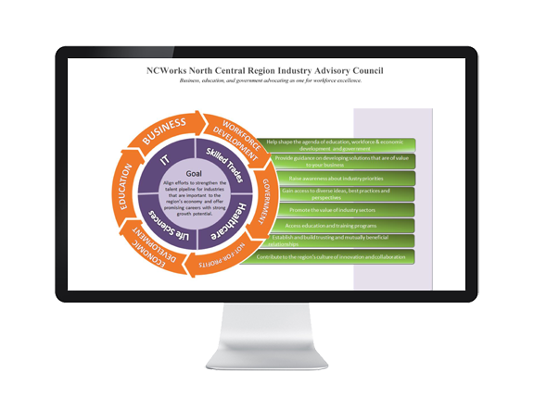
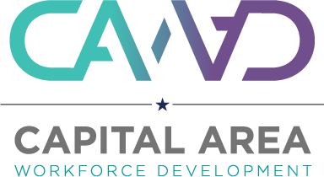
Proven and promising practices
Example_Strategic Function
Eastern Carolina
Work Ready Communities
Lead efforts in the local area to identify and promote proven and promising strategies and initiatives…and identify and disseminate information on proven and promising practices carried out in other local areas…
NCWorks North Central Region Industry Advisory Council (IAC) Framework

Slide 10
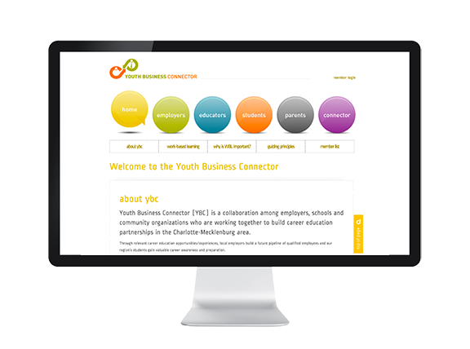
Technology
Example_System Capacity
Centralina
Career Headlight
Develop strategies for using technology to maximize the accessibility and effectiveness of the local workforce development system for employers, and workers and jobseekers…
Charlotte
Youth Business Connector

Slide 12
Questions?
www.ncawdb.org

