Slide 1
North Carolina Offshore Wind & Wildlife Solutions Summit
July 19, 2022 9:30am – 4:00pm

Slide 2
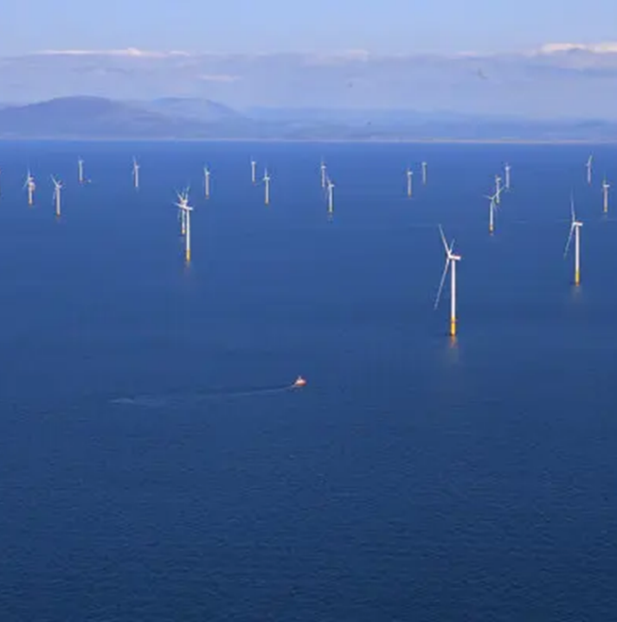
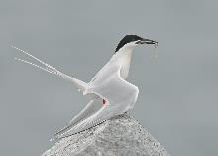
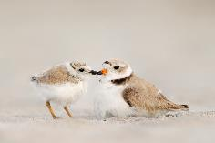
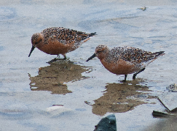
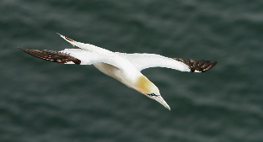
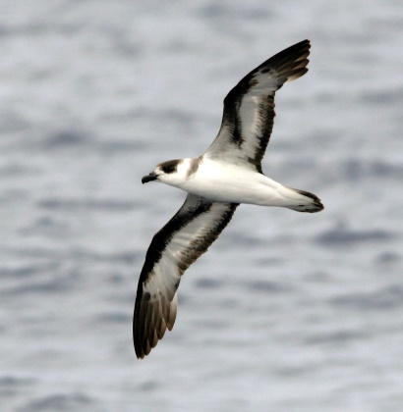
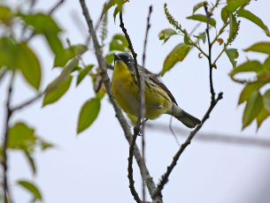
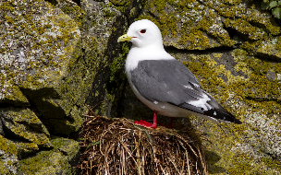
Direct Mortality Risk?
Known priority areas?
Loss of Habitat?
Displacement from quality habitat?
Cumulative impacts?
Notes:
Curtis Smalling 1

Slide 3
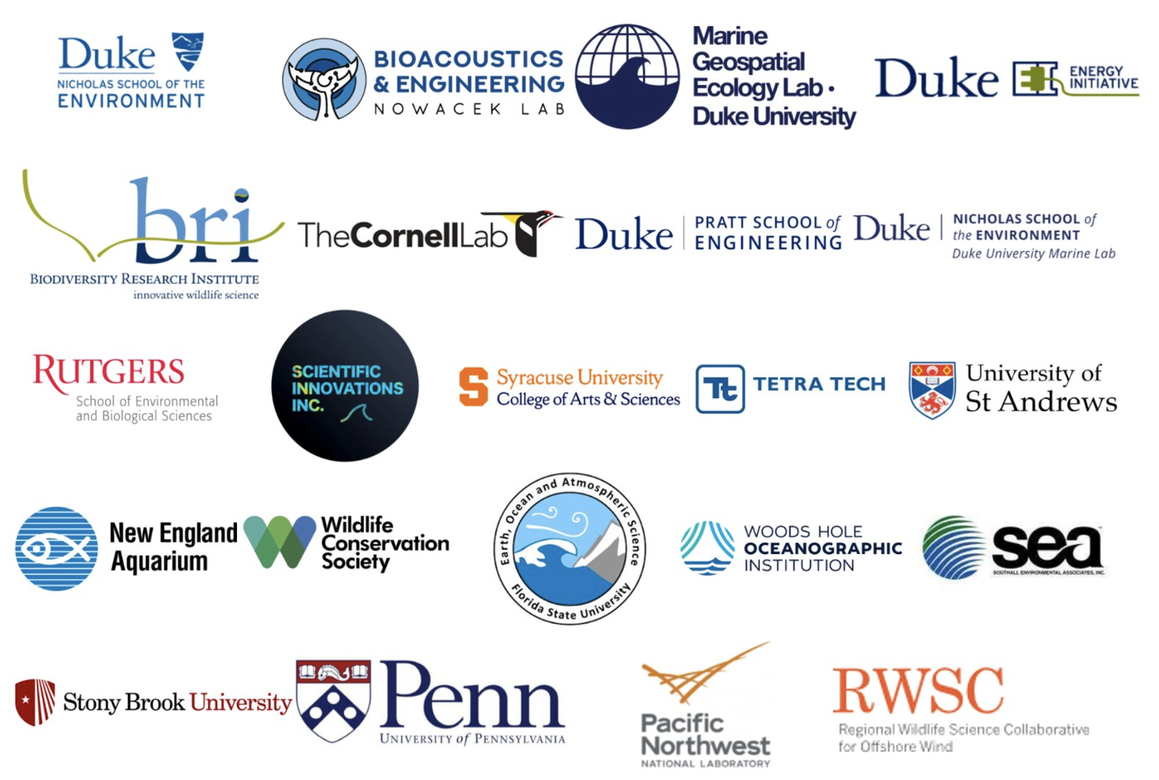
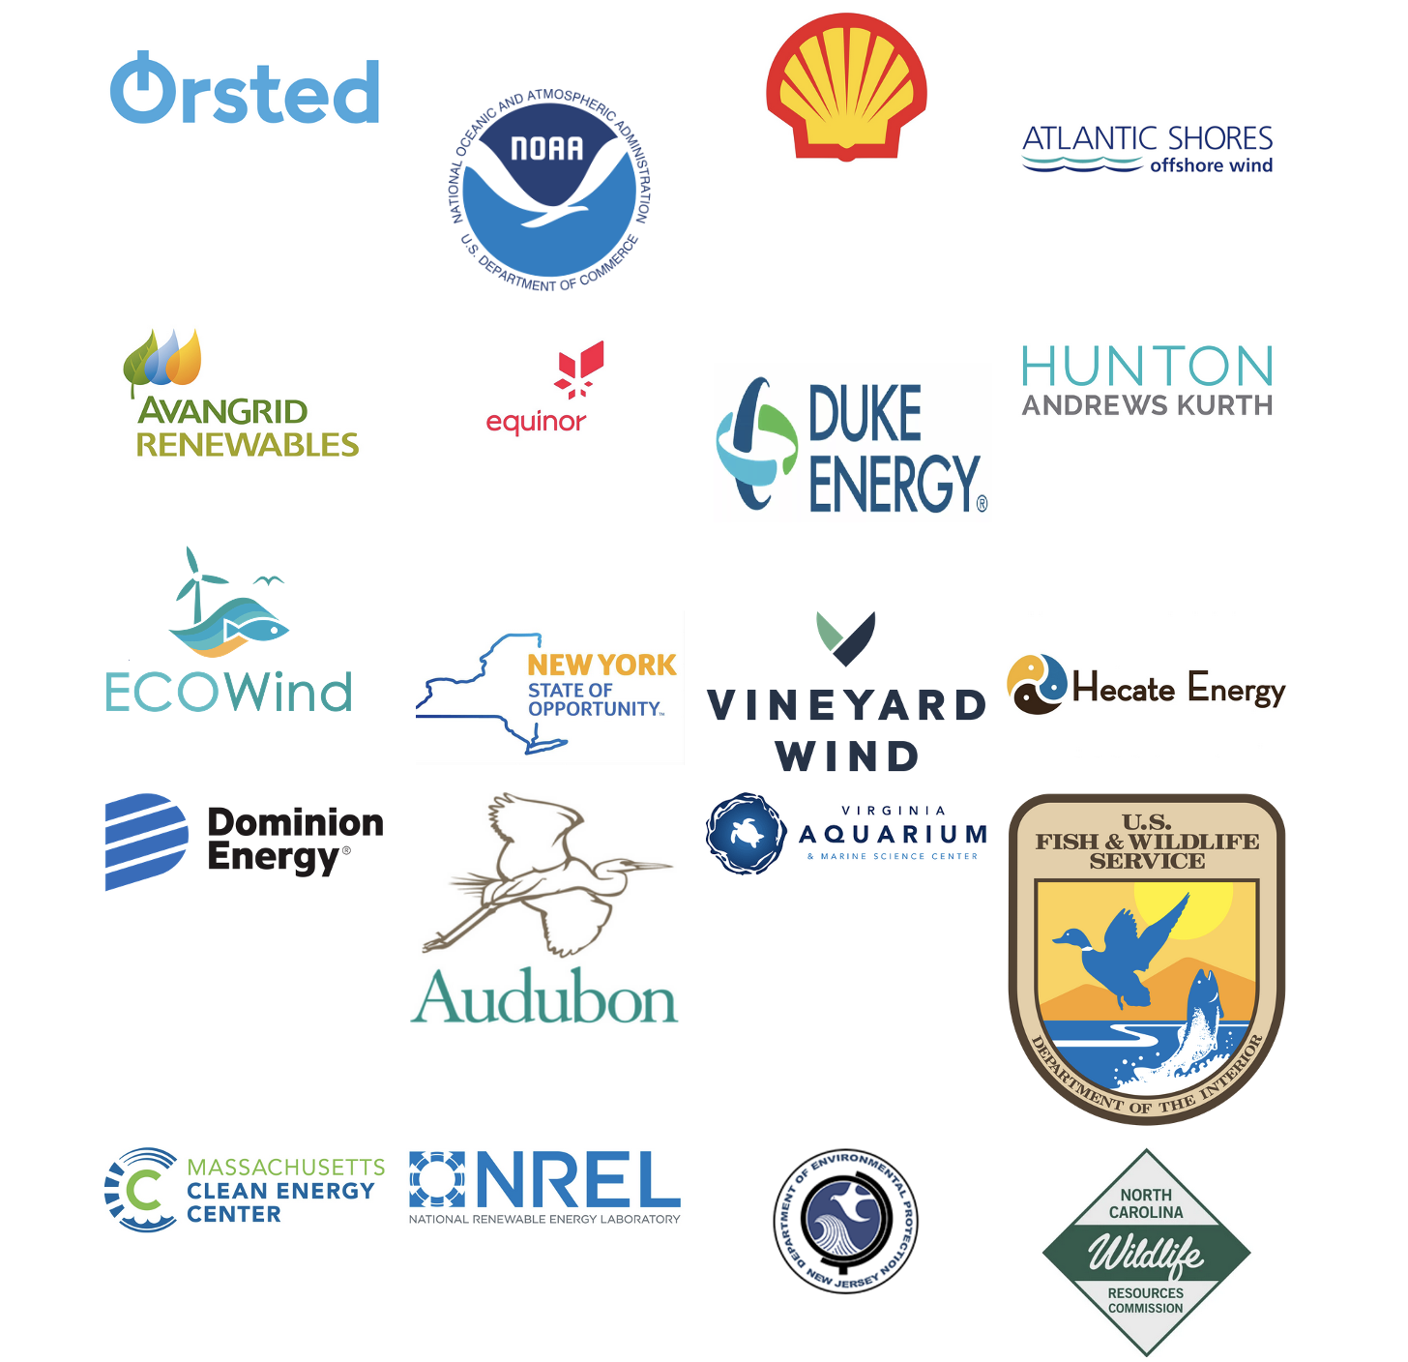
Project WOW research team
Project WOW External Advisory Board
RWSC collaborative partner
Federal agency caucus
State agency caucus
eNGO caucus
Offshore wind energy industry caucus
Notes:
Halpin (virtual) 9

