Slide 1
NCTOWERS quarterly meeting
Thursday August 4, 2022
Update: Offshore Wind Activities
Jennifer mundt, Assistant Secretary
Clean energy and economic development
www.nccommerce.com

Slide 2
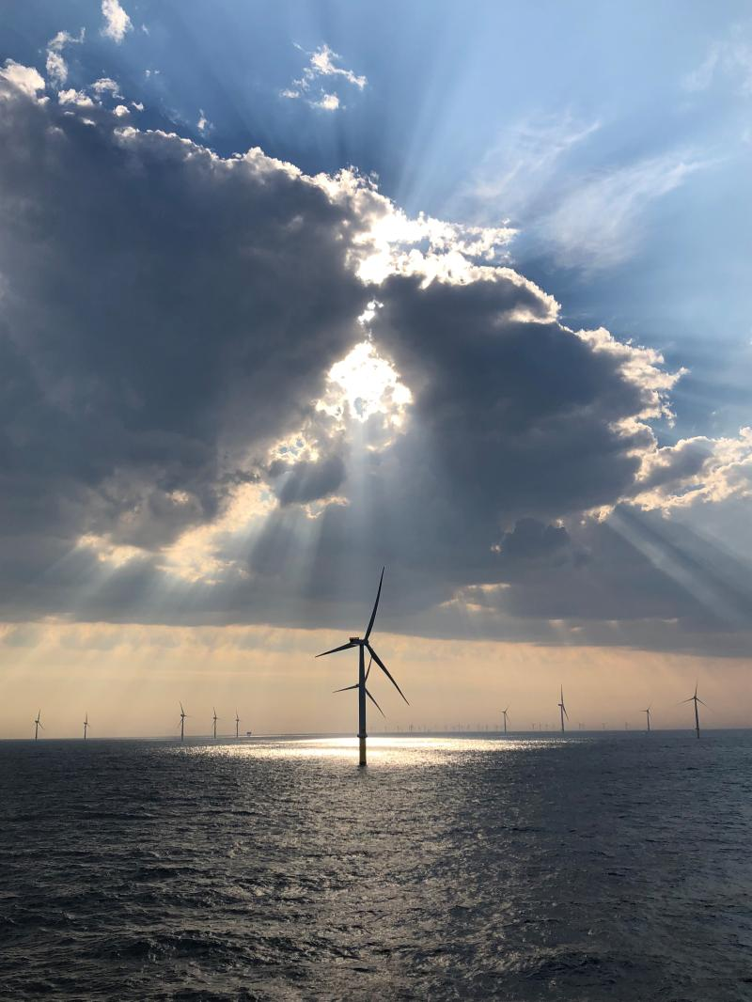
Overview
Federal activities
Federal-State Partnership
Status of Trump-era moratorium
Legislative vehicles
Executive directive
RISEE Act momentum
State activities
Draft Carbon Plan released
NC-UK MOU signed
BOEM executes Carolina Long Bay leases!
Photo: Orsted

Slide 3
Federal Activities Federal-State Partnership
Launched June 23, 2022
11 East Coast Governors
DOE, DOI, and WH Climate Office
Industry and labor leaders
https://romesentinel.com/stories/biden-teams-with-east-coast-governors-to-boost-offshore-wind,136817
Commitment to collaborate:
Build domestic OSW supply chain & workforce
Regional matters; transmission and interconnection
Fishing and other ocean co-use issues

Slide 4
Federal Activities (cont’d) Moratorium Status
Issued September 2020
Bans leases offshore NC beginning July 1, 2022
Legislative vehicles addressing moratorium
Inflation Reduction Act of 2022
National Defense Authorization Act FY 2023
Executive action addressing moratorium
Biden’s July 20th announcement to boost OSW development in the Southeast, including North Carolina

Slide 5
Federal Activities (cont’d) Movement on the RISEE Act of 2022
Reinvesting in Shoreline Economies and Ecosystems Act of 2022
Creates parity in OSW revenue sharing of the operating fees, rentals, bonuses, royalties, and other payments from covered projects, effective January 1, 2022
50% in the Treasury
12.5% in the National Oceans and Coastal Security Fund
37.5% to eligible states (subject to forthcoming rulemaking formula)
May be used for:
Coastal protection
Mitigation of damage
Plan implementation
Mitigate impact of OCS activities

Slide 6
State Activities Duke Released Carbon Plan
HB951 Energy Solutions for NC
Power sector GHG reductions
* 70% by 2030
* Net-zero by 2050
Directs development of a Carbon Plan to achieve these reductions
Draft Carbon Plan released May 16, 2022
4 proposed energy resource portfolios
3 of which include OSW in the mix
https://energynews.us/2021/10/28/for-landmark-new-climate-law-in-north-carolina-technical-concerns-linger/

Slide 7
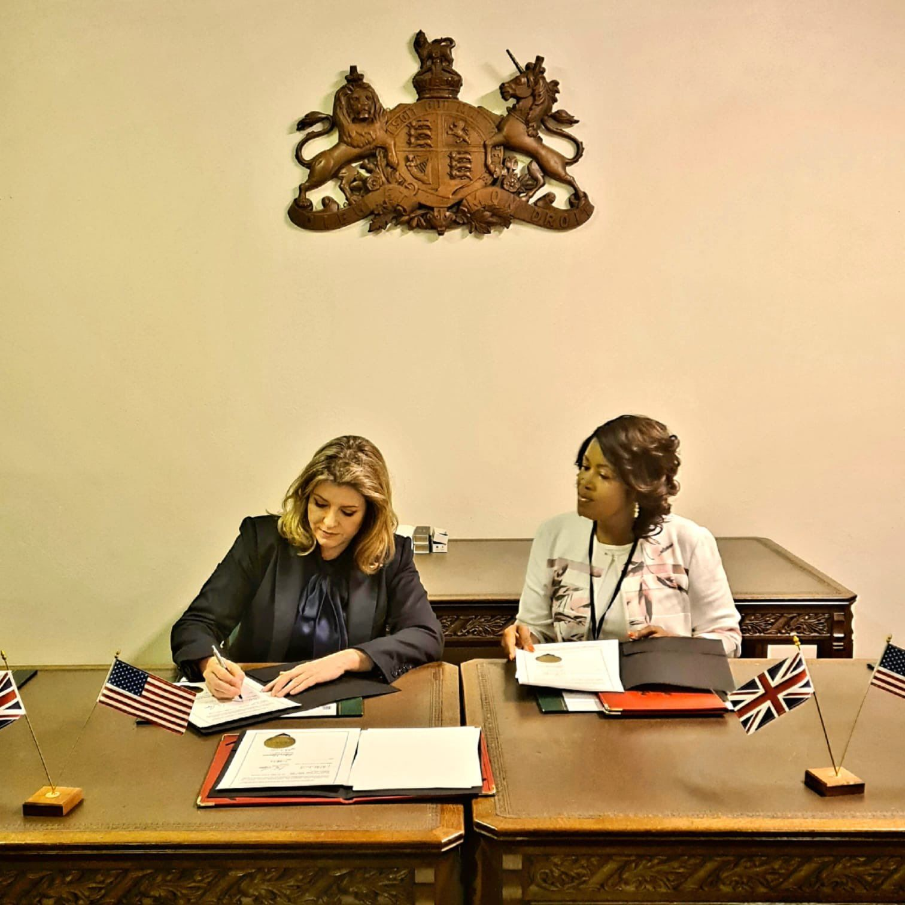
State Activities (cont’d) NC & UK MOU
To strengthen economic ties and transition to a clean energy economy (July 20, 2022)
Cooperate to meet 5 goals
Engage in activities to achieve 5 goals

Slide 8
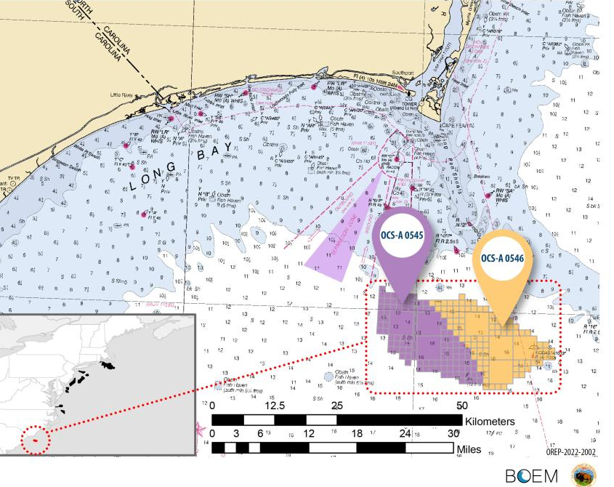
State Activities (cont’d) Carolina Long Bay Leased!
Auction May 11, 2022
TotalEnergies
Duke Energy Renewables
BOEM executed leases June 2022
Site Assessment Plan > COP, when approved
Scoping for EIS
DEIS prepared and published

Slide 9
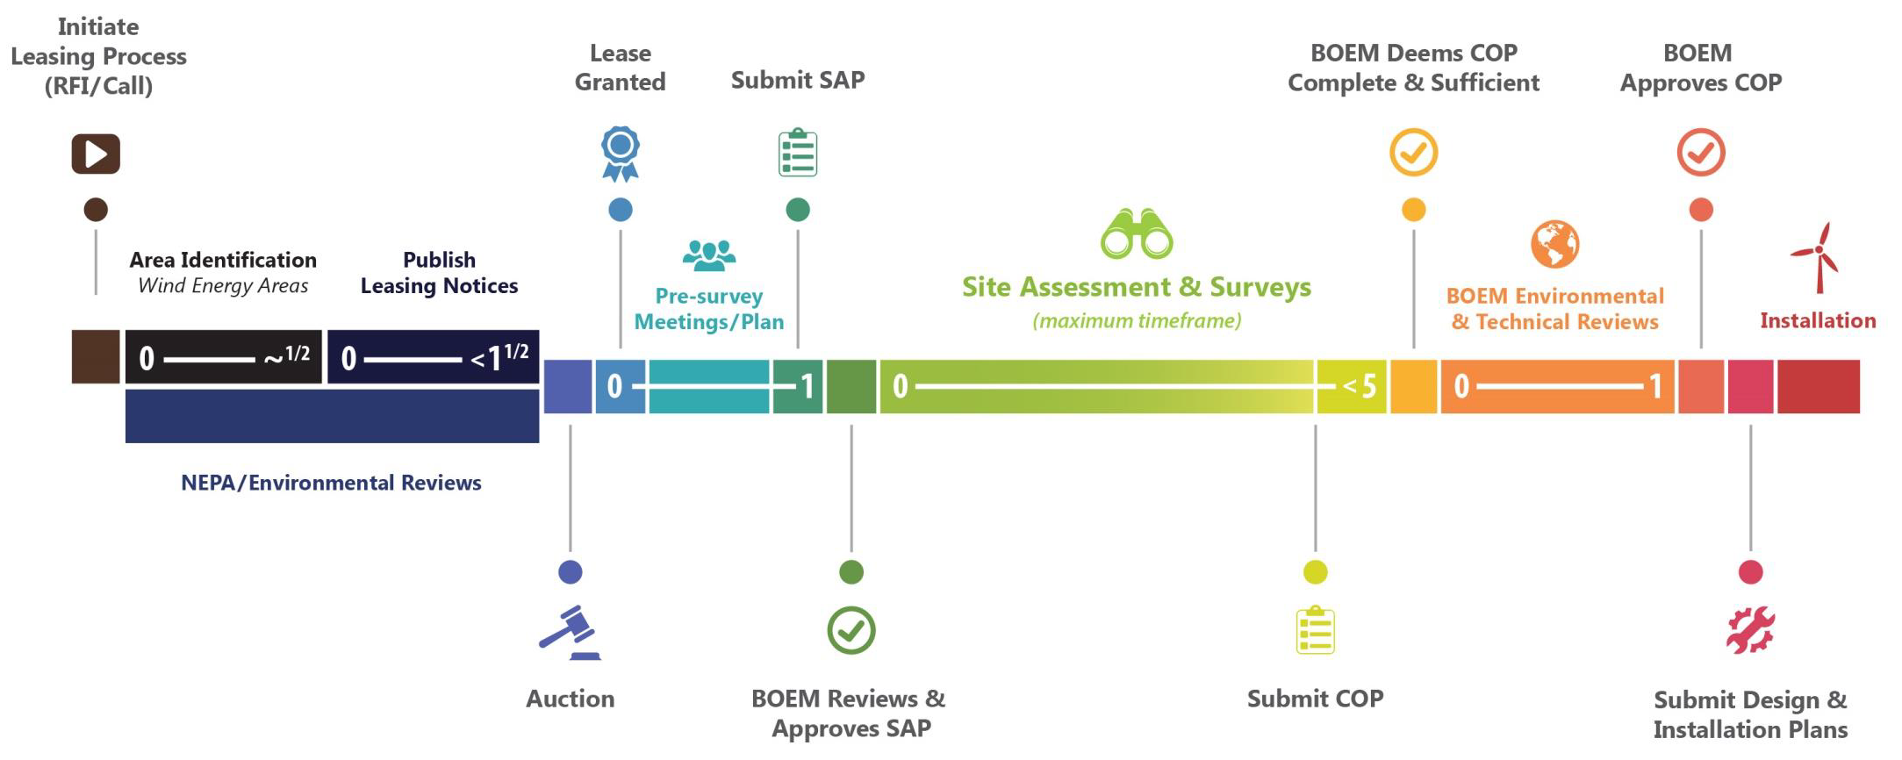
BOEM Renewable Energy Development Process: Leasing to Operations
CAROLINA
LONG BAY
KITTY HAWK
SOUTH
KITTY HAWK NORTH

Slide 10
Questions and Contact Me!
Jennifer Mundt Jennifer.Mundt@nccommerce.com (919) 441-7430
www.nccommerce.com

