Slide 1
NC TOWERS
Eric Thumma
Vice President, New Business -Offshore
August 4, 2022

Slide 2
AVANGRID RENEWABLES OFFSHORE WIND
Part of Iberdrola Group’s Global Portfolio
UK & Ireland
West of Duddon Sands - 389MW
Consent 2011 - COD 2014
Continental EU
East Anglia ONE - 714MW
Consent 2014 - COD 2020
Wikinger - 350MW
Consent 2015 - COD 2017
East Anglia Hub – 3.1GW
Consent 2017-22 - COD 2026/27
Baltic Eagle - 476MW
Consent 2021 - COD 2024
Scotland (3 projects) - 7GW
Consent >2025 - COD >2030
St. Brieuc - 496MW
Consent 2017 - COD 2023
US Hub
Ireland (3 projects) - up to 3GW
Consent >2023 - COD >2028
Vineyard Wind 1 - 800MW Consent 2021, COD 2024
Windanker - 308MW
Consent 2021 - COD 2026
APAC
Park City Wind - 804MW Consent 2023, COD 2025
Japan (Acacia & Aomori) up to 1.8GW
Consent >2022 - COD >2028
Sweden (8 projects) - up to 9GW
Consent >2021 - COD >2029
Commonwealth Wind – 1.2GW Consent 2023, COD 2027
Taiwan - up to 1.2GW
Consent >2023 - COD >2029
Kitty Hawk – 2.4GW
Consent 2023 (ph I) - COD >2027
Philippines - 3.5GW
Consent >2023 - COD >2030
Brazil
Brazil - ~2.7GW
Consent >2024 - COD >2030
1.3 GW operational with 5.5 GW under construction or with secured long-term contracts
Minimum of 12GW (CMD forecast) operational by 2030. Potential of up to 18GW based on development activities.

Slide 3
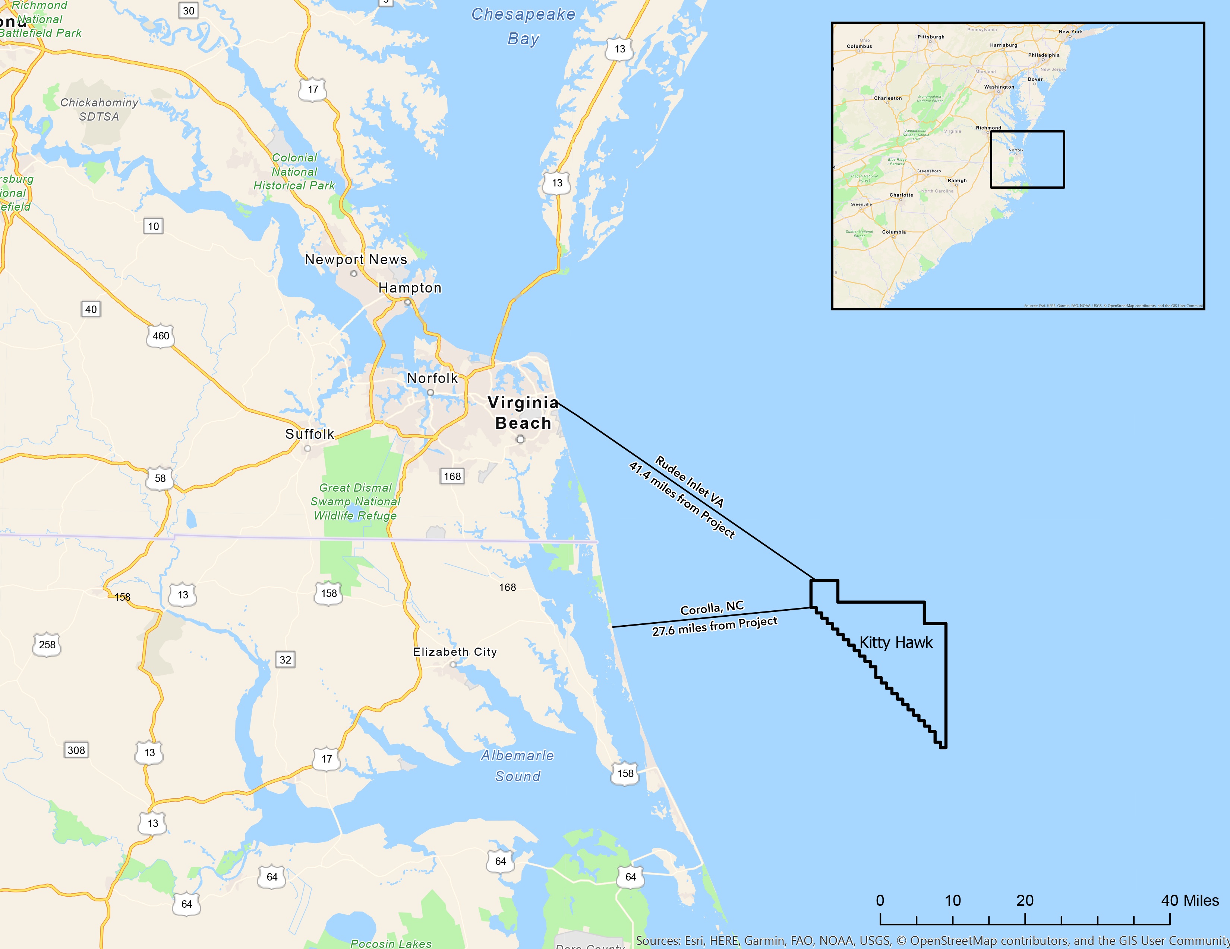
NC TOWERS
Kitty Hawk Lease Area Overview
OWNERSHIP
CAPACITY
100% Avangrid Renewables
2,500 MW
Water Depth
DISTANCE TO SHORE
35 meters average
27 miles off N. Carolina
41 miles off Virginia
Lease Price
POINTS OF INTERCONNECTION
$9 million
Havelock, New Bern, Greenville
COMMERCIAL OPERATIONS DATE
PERMITTING STATUS
2029/30 (NC HVDC Phase I)
Construction and Operations Plan Submitted (April 2022)

Slide 4
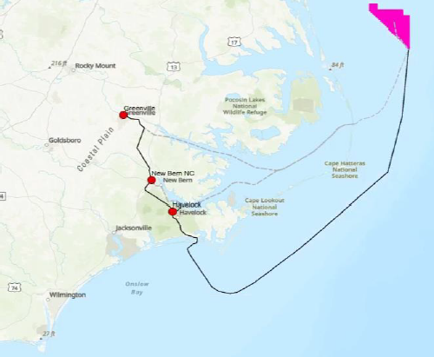
NC TOWERS
Market Opportunities and North Carolina Delivery
Optimized project size for lowest potential LCOE
Potential for 2029/2030 COD
Ports/Supply Chain/Workforce and other investments and partnerships
Potential HVDC routes, onshore routes, and points of interconnection (not final)

Slide 5
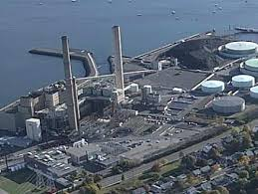
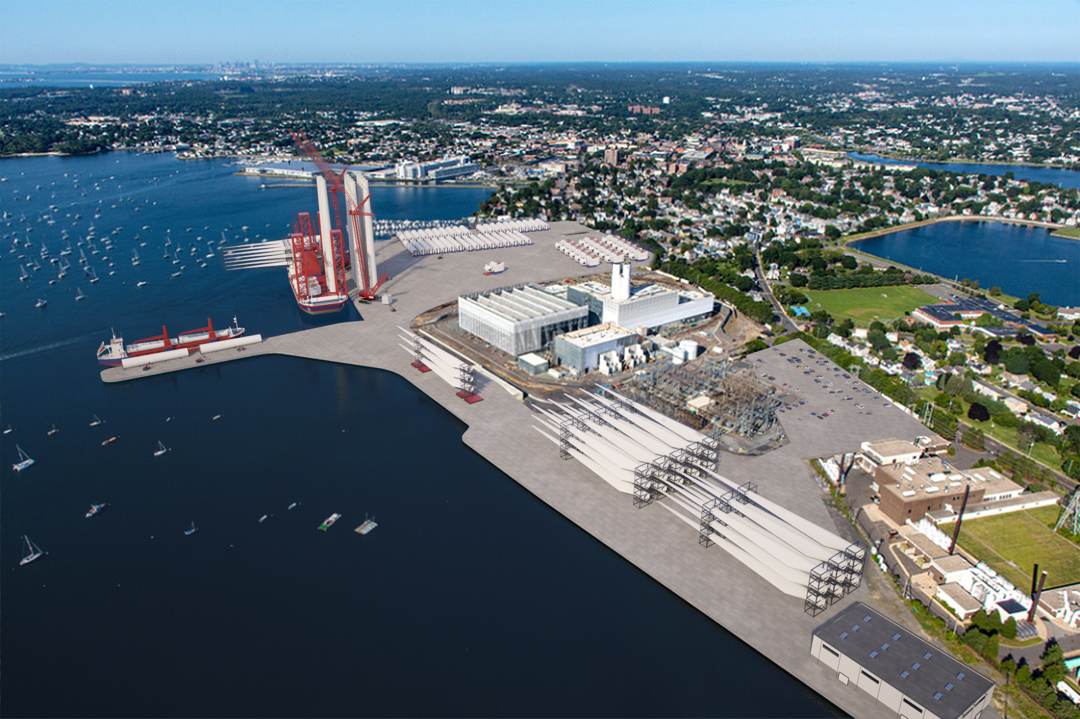
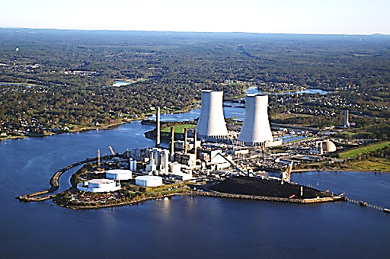
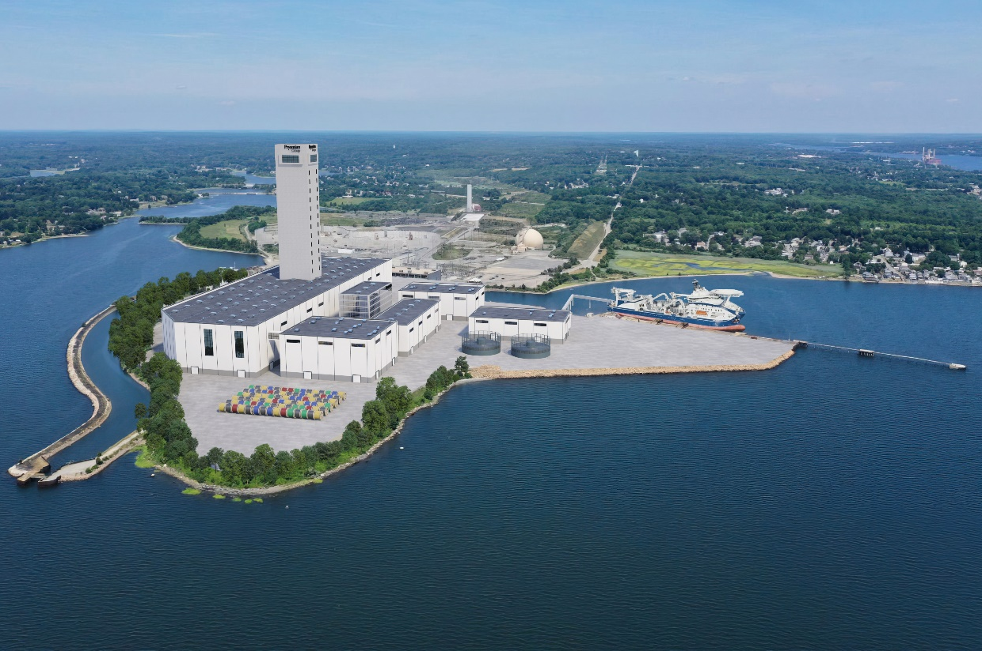
Commonwealth Wind
Delivering on the Promise of the Clean Energy Transition
As part of Commonwealth Wind, two former Coal-Fired Power Plants
will be redeveloped into critical hubs for clean energy jobs
The Transformation of Salem Station into Offshore Wind Marshalling Port with City of Salem & Crowley
Artist rendering
The transformation of Brayton Point into Offshore Manufacturing facility with Prysmian
Artist rendering

